Slide 1
Atomic Cross-Chain Swaps
Maurice Herlihy
Computer Science Department
Brown University
汇报人： 郑镇宇
Notes:
Atomic Cross-Chain Swaps
跨链原子交换
PODC上的一篇文章

Slide 2
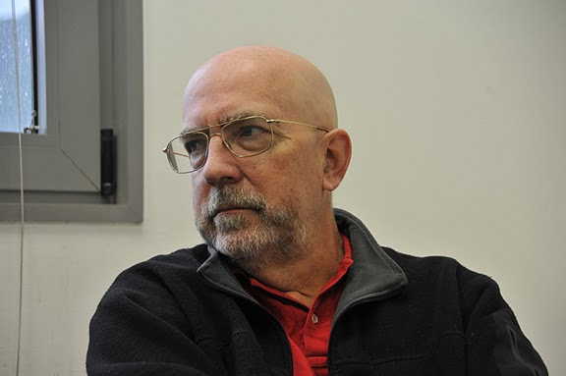
Maurice Herlihy has an A.B. in Mathematics from Harvard University, and a Ph.D. in Computer Science from M.I.T.
He has served on the faculty of Carnegie Mellon University and the staff of DEC Cambridge Research Lab.
He is the recipient of the 2003 Dijkstra Prize in Distributed Computing, the 2004 Gödel Prize in theoretical computer science, the 2008 ISCA influential paper award, the 2012 Edsger W. Dijkstra Prize, and the 2013 Wallace McDowell award. He received a 2012 Fulbright Distinguished Chair in the Natural Sciences and Engineering Lecturing Fellowship, and he is fellow of the ACM, a fellow of the National Academy of Inventors, the National Academy of Engineering, and the National Academy of Arts and Sciences.
Notes:
作者是Maurice Herlihy Computer Science Department Brown University

Slide 3
What is atomic cross-chain swap ?
An atomic cross-chain swap is a distributed coordination task where multiple parties exchange assets across multiple blockchains, for example, trading bitcoin for ether.
Notes:
跨链原子交换是一项分布式协调任务，多方通过多个区块链交换资产，例如，用比特币交换

Slide 4
An atomic swap protocol guarantees
(1) if all parties conform to the protocol, then all swaps take place, (2) if some coalition deviates from the protocol, then no conforming party ends up worse oﬀ, and (3) no coalition has an incentive to deviate from the protocol.
Notes:
该协议保证了
if all parties conform to the protocol, then all swaps take place,
只要所有部分都满足协议，交换就会发生
(2) if some coalition deviates from the protocol, then no conforming party ends up worse oﬀ
如果有一部分偏离协议，就不会有更糟的结束
no coalition has an incentive to deviate from the protocol.
没有一个联盟会有想离开协议的动机

Slide 5



.
Alice
Have alt-coin
Want Cadillac
Bob
Have bitcoin
Want alt-coin
Carol
Have Cadillac
Want bitcoin
Notes:
Carol wants to sell her Cadillac for bitcoins. Alice is willing to buy Carol’s Cadillac, but she wants to pay in an “alt-coin” cryptocurrency. Fortunately, Bob is willing to trade alt-coins for bitcoins.

Slide 6
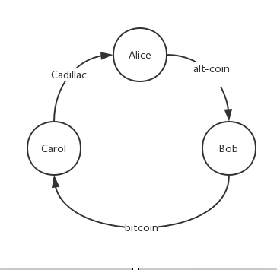
How to finish the trade?

Slide 7
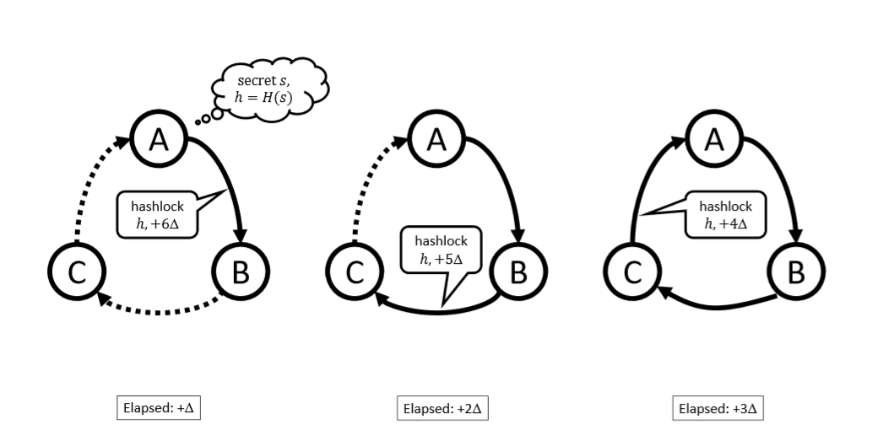
deploying contracts
Notes:
我们先做一个简单的三链交换来进行解释这个协议
三角形代表足够的时间完成推出协议而且被其他人观察到这个协议已经被推出
第一部分是部署阶段

Slide 8
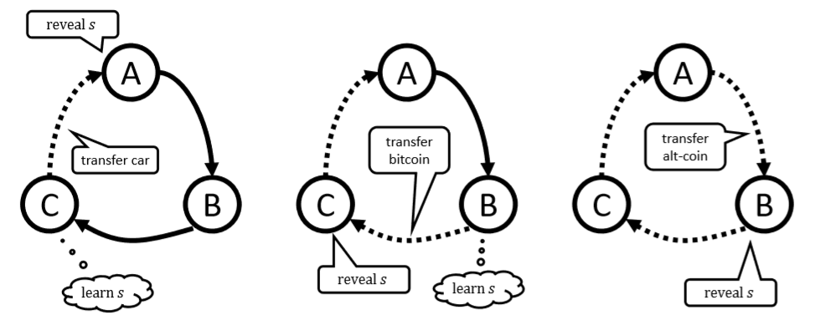
triggering arcs
Notes:
触发弧
• When Alice confirms that Carol’s contract has been published on the title blockchain, she sends s to Carol’s contract, acquiring the title and revealing s to Carol.
• Carol then sends s to Bob’s contract, acquiring the bitcoins and revealing s to Bob.
• Bob sends s to Alice’s contract, acquiring the alt-coins and completing the swap.

Slide 9
Why this protocol is safe ?

Slide 10
Someone break rule in the first phase
合约会终止，没有人会损失
Notes:
第一部分出问题
What could go wrong? If any party halts during the ﬁrst phase, when contracts are deployed, then all contracts eventually time out and trigger refunds.
所有钱都会退还

Slide 11
Someone break rule in the second phase
违约方只会损害自己的利益，别人不受干扰
Notes:
如果第二部分出问题，只有违背合约的人会利益损害

Slide 12
POINT
Order
2. Timelock

Slide 13
Order
If Carol were to post her contract with Alice before Bob posts his contract with Carol, then Alice could take ownership of the Cadillac without paying Carol.
Notes:
顺序十分重要
如果C在B给C之前就推出了C对A的合约，那么A就可以得到C却不用支付给C

Slide 14

Timelock
If Carol’s contract with Bob were to expire at the same time as Bob’s contract with Alice, then Carol could reveal s to collect Bob’s bitcoins at the very last moment, leaving Bob no time to collect his alt-coins from Alice.
Notes:
时间锁非常重要。

Slide 15
A cross-chain swap has an associated directed graph D = (V,A). For any pair (D,L), where D = (V,A) is a strongly-connected directed graph and L ⊂ V a feedback vertex set for D, we give an atomic crosschain swap protocol using hashed timelock contracts, where the vertexes in L generate the hashlocked secrets. We show that no such protocol is possible if D is not strongly connected, or if D is strongly connected but L is not a feedback vertex set.
The protocol has time complexity O(diam(D)) and communication complexity (bits published on blockchains) O(|A| · |L|).
Notes:
推而广之我们可以把跨链原子交换比作一个强连通的有向图，
用回馈点集合来生成secret

Slide 16
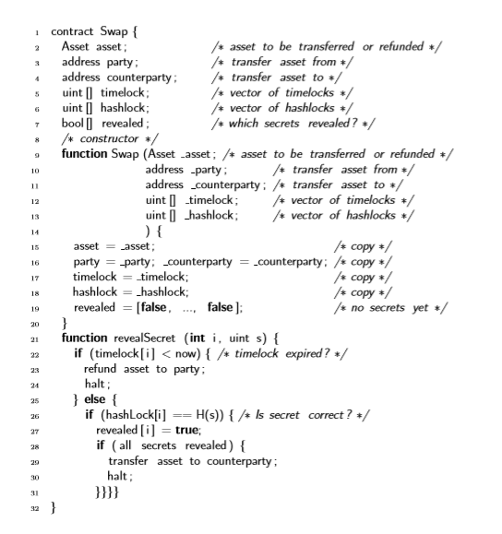
Without leader

Slide 17
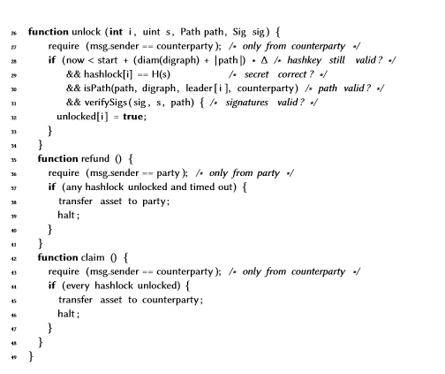
With leader

Slide 18
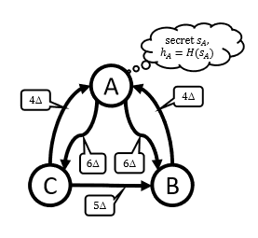
A is leader, B and C are followers
Notes:
A是leader， 他先把两个时间锁给B和C
在离开leader的每条弧线上都发布一份合约。
等待直到所有进入领导者的弧线上的合约被公布。

Slide 19
Q＆A

